Slide 1
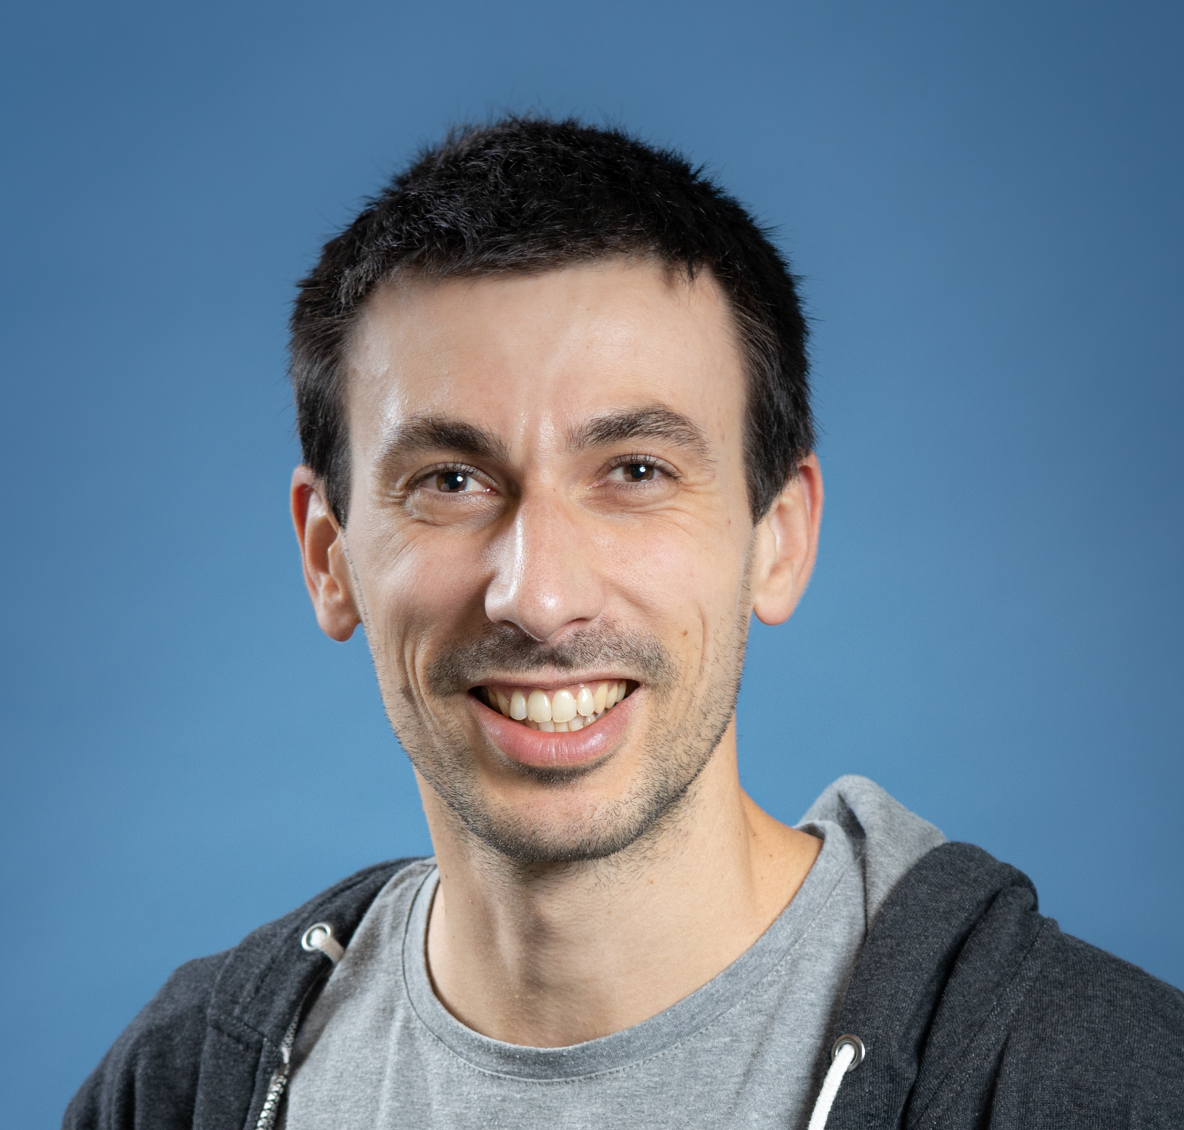



Comment construit-on des intelligences artificielles ?
Guillaume Chervet
TechLead – ML Engineer
Direction Transfo et Tech - AXA France
@guiChervet
2024
Notes:
What is MLOps? This is all things that will help and support the fact of bringing artificial intelligence algorithms into production, it is not about tools or technologies; it is mainly a question of culture and good practice.
Hi, my name is Guillaume Chervet, I'm an ML engineer at AXA France. Basically, I define my role as helping data scientists to bring AI algorithms into production.
I‘m part of a team that works on real-time automatic document understanding projects. Generally, this kind of projects implements one or more Deep Learning algorithms.
Today, almost 80% of projects fail at the production stage. This does not surprise me because, this kind of projects are on the top complexities in all areas, all factors are met to make them fail.

Slide 2
Stake 1
Software Engineer
Data Scientist
Ops
Comment construit-on des IA? – Guillaume Chervet
Notes:
The first problem is a human problem, so today most applications require Developers and Operation engineers and it's already not easy to get everyone working together. On AI projects, we should also add a lot of expertise about data. We need Data experts.
Today, it’s almost impossible to be an expert in these 3 areas. Each party will have to trust one another and accept other party’s constraints.

Slide 3
Email classification
Stake 2
 | Training env. (AzureML) | Production env. (OpenShift) | Total default run cost
2022 | 2700 € / month | 6000 € / month (dev, staging, pre-prod, prod) | 8 700 € / month
2024 | 400 € / month | 2000 / month (dev, staging, pre-prod, prod) | 2400 € / month
Comment construit-on des IA? – Guillaume Chervet
Notes:
The second problem is the fact that we work on projects that are generally extremely expensive.
This is an email classification project that worked very well. For us, it's an example project to follow.
Today the operating cost of the project per month is approximately 9 000 €, that’s a little more than 100,000 € per year. I think that we can still divide the costs by 2. Today on this project we classify about 10,000 emails per day. So, we estimate that each email classification costs about 3 cents euro.
For example, If we decide to carry out one “model retrain” per year, the cost of one email classification will increase to 4 cents euro. And here, I’m excluding the first implementation of the project… which cost a little more than 1 000 000 euros!

Slide 4

Classification
Claims Contract
Invoice
Attachment
Other
email
"envelope upside an old white paper"
Comment construit-on des IA? – Guillaume Chervet
Notes:
Here is a functional example of a mail classification
.
For your information, all images you see here with a small text below are generated by an artificial intelligence algorithm.

Slide 5
Today Agenda
Introduction to AI and Deep Learning
What do we expect from a project in production?
How to train an AI?
Notes:
In this part we are going to give feedbacks based on different experiences. This allowed us to learn what NOT to do.
To make it fun, we are going to open a pizzeria and we are going to organize to serve pizzas to our customers. We're going to put everything in place to make our pizzeria fails to deliver a good meal.

Slide 6
Today Agenda
Introduction to AI and Deep Learning
What do we expect from a project in production?
How to train an AI?
Notes:
In this part we are going to give feedbacks based on different experiences. This allowed us to learn what NOT to do.
To make it fun, we are going to open a pizzeria and we are going to organize to serve pizzas to our customers. We're going to put everything in place to make our pizzeria fails to deliver a good meal.

Slide 7
Deep Learning
Artificial Intelligence
Machine Learning
Deep Learning
Supervised
Comment construit-on des IA? – Guillaume Chervet
Notes:
One of the subsets of artificial intelligence is machine learning and one of the subsets of machine learning is deep learning.

Slide 8
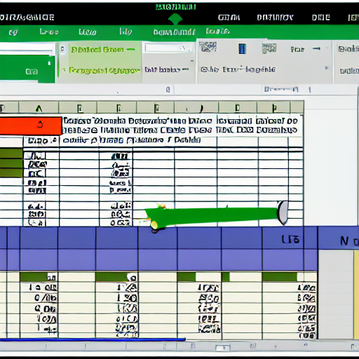
Deep Learning
Structured data
"excel structured data"
Comment construit-on des IA? – Guillaume Chervet
Notes:
You will often hear about structured data usually being represented by an Excel file. In general, for this kind of problem where there is a limited number of inputs/outputs. We will use simple machine learning algorithms.

Slide 9


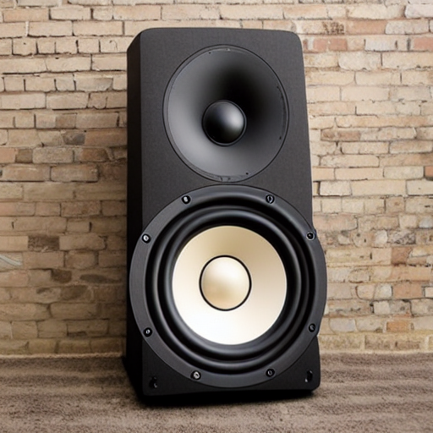
Deep Learning
Unstructured data
"text from an old book on a table"
"camera outside on the beach"
"big music speaker"
Comment construit-on des IA? – Guillaume Chervet
Notes:
When we have data like: sounds, images, videos. The number of possible inputs/outputs is generally higher. Consequently, we will generally use Deep learning algorithms which use neural networks.

Slide 10

3 Paradigm shift
Comment construit-on des IA? – Guillaume Chervet
Notes:
slide / ! \ Attention changement important. Mettre un marqueur pour y revenir ensuite à la fin.

Slide 11

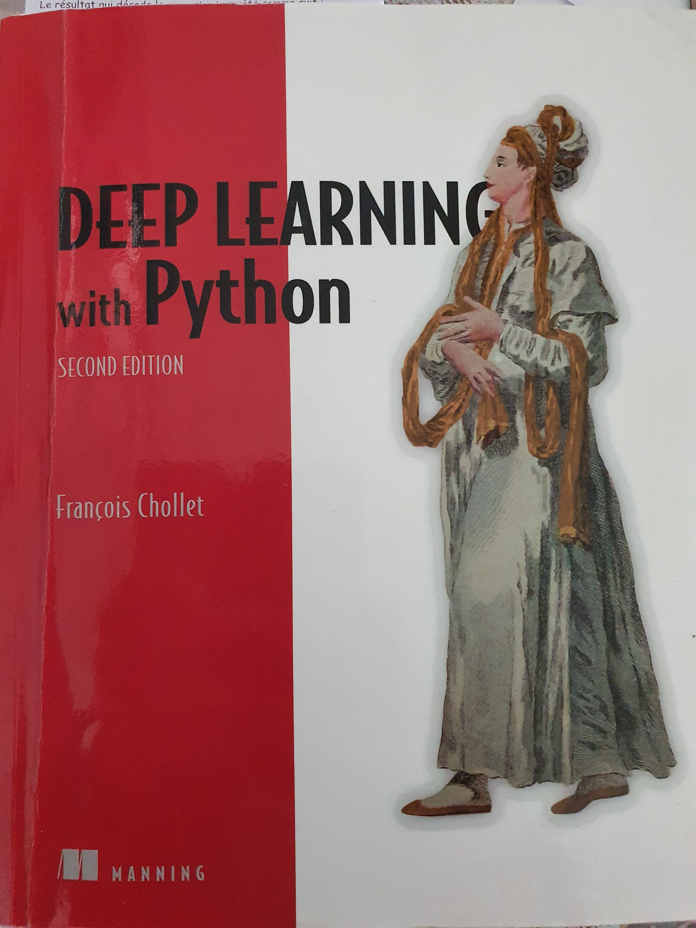
Deep Learning
1) Paradigm shift : Skills
Classical programming
Rules
Answers
Data
Machine Learning
Data
Rules
Answers
Comment construit-on des IA? – Guillaume Chervet
Source : François Chollet
Notes:
Changement de paradigme : compétences, projets, etc.

Slide 12
Deep Learning
1) Paradigm shift : Skills
Code
Data
Answer
AI model
Data
Answer
Comment construit-on des IA? – Guillaume Chervet

Slide 13

Deep Learning
2) Paradigm shift : Data
Comment construit-on des IA? – Guillaume Chervet
Notes:
In the past, we used to talk about project as “model centric”, because we weren't sure we could make an appropriate AI.
Today most of the points on the AI ​​side: at least for our needs at AXA France, already have viable solutions. We know that we will be able to create an AI for our use cases.
On the other hand, the heart of the problem, really the thing that makes a project feasible or not: it is the data. If we have good data, of good quality, inputs and answers, a lot, that will really be game changer to the success of your project. The data is your treasure that will make the difference.

Slide 14

Ecotag
Deep Learning
3) Paradigm shift : It’s alive
Comment construit-on des IA? – Guillaume Chervet
Notes:
Changement : c’est vivant, comme qqun qui apprend, il doit continuer à s’adapter. Et donc on doit relivrer fréquemment pour s’adapter aux nouvelles data.

Slide 15
Deep Learning
collect
Datasets
Comment construit-on des IA? – Guillaume Chervet
Notes:
So now, we are going to explain the workflow of a project. We want to build an email classification project.
The first thing to do is to retrieve data: inputs and answers. On this project, it was easy. We already had emails and answers because in production we already have humans who have been classifying the emails manually for several years. So, we already have the data and the answers, that's perfect to build up our first dataset.

Slide 16
Deep Learning
collect
Datasets
use
Train AI
Comment construit-on des IA? – Guillaume Chervet
Notes:
Then, with this data, we will be able to iterate to create an AI and build an API that we can put into production.

Slide 17
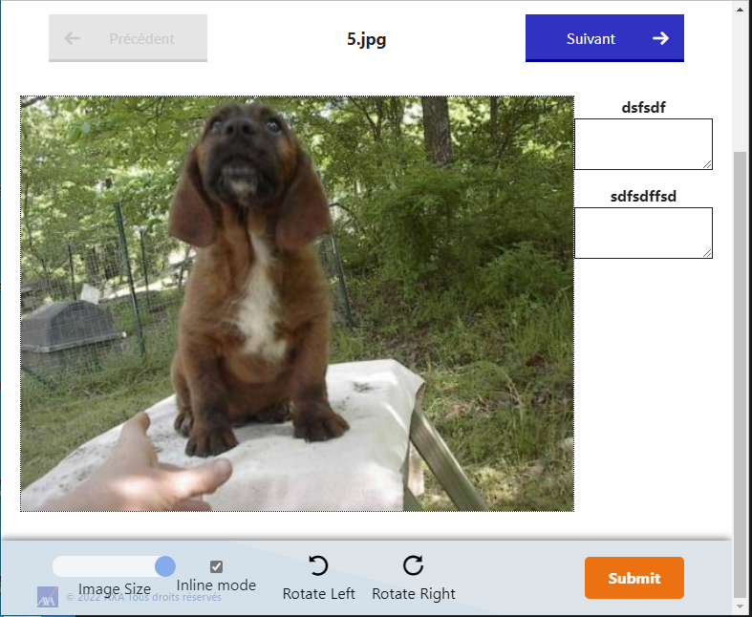
Labelling
Deep Learning
collect
Datasets
use
Train AI
Comment construit-on des IA? – Guillaume Chervet

Slide 18
Labelling
Deep Learning
collect
Datasets
use
Train AI
deploy
Production AI API
Comment construit-on des IA? – Guillaume Chervet

Slide 19
Labelling
Deep Learning
collect
Datasets
use
Train AI
deploy
Production AI API
use
Consumer Production application
Comment construit-on des IA? – Guillaume Chervet
Notes:
After that, our application in production can be consumed by client applications.

Slide 20
Labelling
Deep Learning
collect
Datasets
use
Train AI
deploy
Production AI API
use
Consumer Production application
collect
Feedback Loop
Comment construit-on des IA? – Guillaume Chervet
Notes:
In production, it is extremely important to set up what is called: the “feedback loop”. A virtuous circle. In the event of a classification error, the client applications must allow the error to be corrected manually. Over time, we will be able to build new dataset of a better quality and we will be able to improve our Artificial Intelligence.

Slide 21
Demo
Deep Learning
Source :
Dogs vs. Cats | Kaggle
Comment construit-on des IA? – Guillaume Chervet
Notes:
We're going to do a demo of how a project workflow based on a well-known cat and dogs dataset from Kaggle.

Slide 22
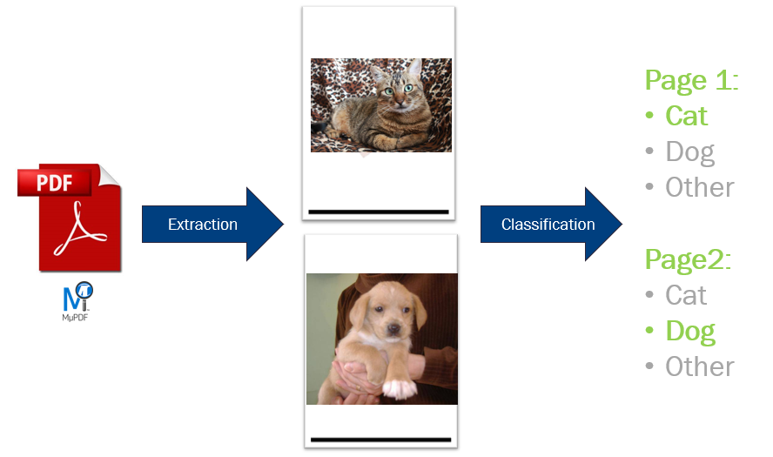
Comment construit-on des IA? – Guillaume Chervet

Slide 23
Dataset of 20 000 files
Deep Learning
Train a model
13 000 train
4 000 validation
3 000 test
Comment construit-on des IA? – Guillaume Chervet
Notes:
Before starting the demo. Imagine that we have 20,000 files available. We will use 17,000 files for training the model. Then we will keep 3000 files aside for validation, to test our model on data it has never seen. This validation DATASET will also be used to test our production environments.

Slide 24
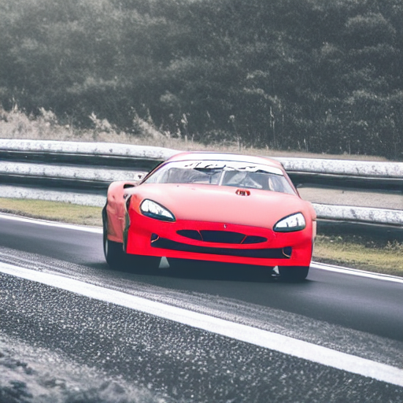
Data drift
Deep Learning
"a race car drift deep on a road in a bend"
Comment construit-on des IA? – Guillaume Chervet
Notes:
Slide 20 After Demo Data drift
If we feed our models with different data. Data very different on which models have learned. Predictions may deteriorate.
For our email classification project, for example, if there is a change of layout for the accident report, it is possible that the AI ​​will fail to recognize automobile claims. In this case, it is necessary to retrain and then re-deploy model in production.
Let's takes a sample with our Demo. Now let's imagine that our users start using plush or inpainting cats and dogs, as you can see the predictions no longer work correctly.

Slide 25

Deep Learning
"the god graal trophy"
Comment construit-on des IA? – Guillaume Chervet
Notes:
The Holy Grail for us; is to be able to re-train and re-deploy in production without any manual action

Slide 26
Deep Learning
Configuration
Data Collection
Data Verification
Machine Resource Management
Serving Infrastructure
Monitoring
ML Code
Analysis Tools
Feature Extraction
Process Management Tools
Source : Google, The Hidden Technical Debt In Machine Learning Systems
Comment construit-on des IA? – Guillaume Chervet
Notes:
This is a Google slide, a Deep learning project is a little bit less than 5% of data science, however it is 100% code!

Slide 27
Today Agenda
Introduction to AI and Deep Learning
What do we expect from a project in production?
AXA Lessons Learned
Recipes to fail an ML project
How to stack the odds in your favor ?
Notes:
In this part we are going to give feedbacks based on different experiences. This allowed us to learn what NOT to do.
To make it fun, we are going to open a pizzeria and we are going to organize to serve pizzas to our customers. We're going to put everything in place to make our pizzeria fails to deliver a good meal.

Slide 28
Production
Answer users’ needs
Accurate AI predictions
Cheap
Fast
Secured
Monitored (data drift)
Fast retrain/deployment
Comment construit-on des IA? – Guillaume Chervet
Notes:
The most important thing in a project is to meet user’s needs.
User wants a good prediction quality,
User wants the cheapest project as possible,
User doesn’t want to wait for a result. At AXA France we must answer a prediction in less than 10 seconds for our use-cases.
Safety is non-negotiable.
We want the projects to be monitored. The idea is that if DATA DRIFT starts, this risk causing a production incident. If we are on a major project that can block AXA France, we are not going to wait for the incident to come.
So, the last point, we must be able to re-train and redeploy quickly. If we have a major incident that blocks AXA France, we must be able to re-deploy as quickly as possible and not wait months to unblock the situation.

Slide 29

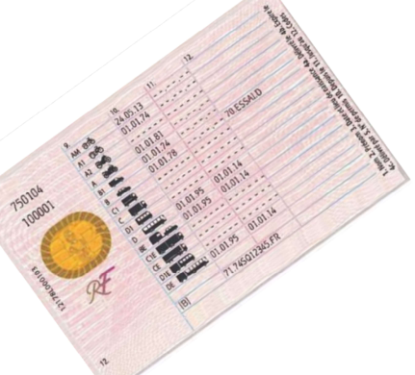





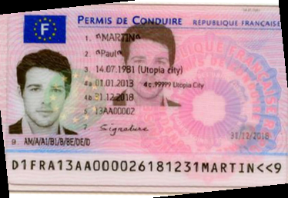
Production
Page
Zoning
Homography
Zoning
Zoning
OCR
OCR
Split
Split
Zoning
Homography
Zoning
OCR
Legend :
ML + code
Only code
Comment construit-on des IA? – Guillaume Chervet
Notes:
So there, it’s the functional diagram of the workflow which explains how machines reads a French driving license. We also read the old French driving licenses, but for simplicity we do not display them here.
The idea is that we will receive an image or a PDF as an input. For the first step, we extract each PDF page as an image. On each image we will run a zoning algorithm to detect the fronts and backs. Now, let's take the front at the bottom, we will first straighten the image of the front with a specific algorithm. Then run another algorithm to zone the fields. Finally run an OCR to finely extract the text.
If we hosted an API that exposes this service in monolith mode. We would have several problems. The first is the response time, when we call this kind of API in monolith what will happen is that each algorithm will consume all the CPU resources of the machine. The consequence is that the pipeline will run sequentially, if we proceed like that, the response time is greater than 30 seconds.
Another problem is that during these 30 seconds: if another HTTP call arrives to the API; this call will have to wait for the end of the first processing before to start processing. So, you will tell me that we can add machines; but another problem and if we host this in monolith mode, we need machines with about 32 gigabytes of RAM, which is very expensive. That kind of monolith is also very slow to start. It's going to be very complicated to be able to scale quickly and to adapt infrastructure to user’s load.
The solution is to set up microservices. We will host each algorithm using different resources which allow us to finely configure the necessary RAM and CPU. We will be able to play the algorithms in parallel and to scale quickly. Response time will be quicker.

Slide 30

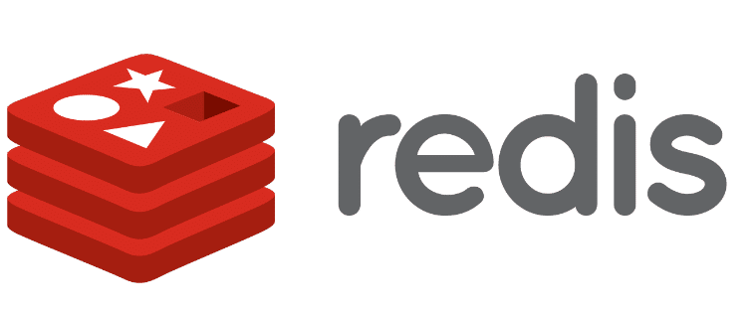
Production
input
output
Function
FaaS
FaaS
Queue A
Queue B
Comment construit-on des IA? – Guillaume Chervet
Notes:
How does it technically work? We use functions. Each algorithm is hosted on a function. This function listens to a Queue as input and as soon as it has free time, it will be able to pop the messages that come from the Queue and to process them.
For example, let’s take the SPLITTER which extracts each page of a PDF an image, the function will retrieve a message with a file identifier from the Queue, the files are stored in REDIS. With the identifier, we will fetch the document from REDIS to run our algorithms and for example if we have a PDF with 2 pages, we will extract 2 images then generate 2 identifiers; push the images into REDIS with them. We finally add 2 messages in the downstream QUEUE to be able to call the following service, in this case the Zoning of the French driver license.

Slide 31
Function
Production
Function
input
output
FaaS
Function
FaaS
Queue A
Queue B
Function
Comment construit-on des IA? – Guillaume Chervet
Notes:
The advantage of working like this. You can scale quickly and support peak loads. Imagine that suddenly, we receive 500 French driver licenses, the number of functions will increase to be able to unstack the messages more quickly. There is also a financial advantage because you only consume what you need.

Slide 32
PDF, IMAGES
JSON Response
OCR
Input HTTP call
HTTP Callback
Receiver
Orchestrator
Queue
New license - frontside
Queue
Homography
Zoning
Queue
Queue
Splitter
Table Zoning
New license - backside
Queue
Homography
Zoning
Table Rotation
Queue
Queue
Queue
Zoning
Queue
Old license - frontside
Homography
Zoning
Table Classifier
Table Rotation
Queue
Queue
Queue
Queue
Comment construit-on des IA? – Guillaume Chervet
Production
Notes:
So that's the architecture diagram. If you find it complicated, that's normal because it's complicated.
I will not describe the entire schema, but in summary, it is an asynchronous architecture.
Look at the top left of the schema. The first POD will receive a document and push it straight into REDIS then, with the file identifier it will add a message in the upstream QUEUE of the splitter. Then the Splitter will retrieve the file, process it, etc. etc.
This architecture works for real time and in Batch mode.

Slide 33
Pain points
Production
Comment construit-on des IA? – Guillaume Chervet
Notes:
These projects are not without challenges.
I will present you the 2 most important difficulties that we meet.

Slide 34
Quicker response
Production : Pain points
Better prediction
Cheaper
Comment construit-on des IA? – Guillaume Chervet
Notes:
First, there is an iron triangle of choice. A cursor to position between the prediction quality, the response time and the cost of the infrastructure in production.
If we want to have the best quality of prediction, we can agree to pay more or lose some response time.
But, if you want to be able to respond more quickly, you must be able to accept either to pay more or to lose prediction quality.
Finally, if we want the project to cost less in production, we must either agree to extend the response processing time or reduce the quality of prediction.

Slide 35
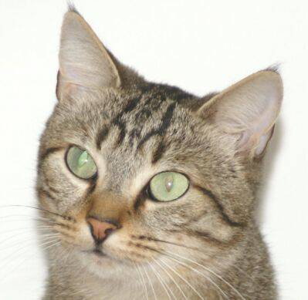
Spot 7 differences
Production : Pain points
Comment construit-on des IA? – Guillaume Chervet
Notes:
So, do you see the differences here?
The differences in these images, we cannot see them, however the AI ​​can!
I had first experience of this problem on our very first project. Pillow library was used to resize images, and which was no longer up to date. As we must always maintain libraires up to dates. As a good developer, I updated it. What happened next, is that predictions did not work anymore. So, I looked at the pictures. Images was identical to my eyes. It was impossible for me to understand what happened. And in fact, for AI images were very different. AI received different bits as an input. The consequence of this problem is that if in production we do not use the same libraries version, python version, and operating system than during training, it may not work.
Back to the demo. The AI ​​algorithm was trained with images resized to 200*200 pixels via Pillow library.
Story: On the driver's license project, we changed all images resize from Pillow library to OpenCV, which allowed us to save a little less than 2 seconds in the global pipeline time.
In this demo I have also implemented a version where images in production are resized with OpenCV before prediction.
Watch, if I predict with images resized via Pillow and then with via OpenCV I don't always get the same results.
I carried out a test with 12500 images and we have around 500 different predictions.

Slide 36
Production : Pain points
Page
Zoning
Homography
Zoning
Zoning
OCR
OCR
Split
Split
Zoning
Homography
Zoning
OCR
Legend :
ML + code
Only code
Comment construit-on des IA? – Guillaume Chervet
Notes:
This only makes 3% prediction differences, but if you take a complex pipeline, where we chain algorithms with different AIs. 3% will propagate thought the pipeline, so at the end the prediction rate becomes very low.

Slide 37
Today Agenda
Introduction to AI and Deep Learning
What do we expect from a project in production?
How to train an AI?
Notes:
In this part we are going to give feedbacks based on different experiences. This allowed us to learn what NOT to do.
To make it fun, we are going to open a pizzeria and we are going to organize to serve pizzas to our customers. We're going to put everything in place to make our pizzeria fails to deliver a good meal.

Slide 38
guillaume-chervet/MLOpsPython (github.com)
Comment construit-on des IA? – Guillaume Chervet

Slide 39
Extraction
Model registry
Dataset pdfs
DataSplit
Train
Test
Dataset Integration
Dataset labels
Comment construit-on des IA? – Guillaume Chervet

Slide 40
Extraction
Dataset pdfs
Comment construit-on des IA? – Guillaume Chervet

Slide 41
Extraction
Annotations
Dataset pdfs
Dataset labels
Comment construit-on des IA? – Guillaume Chervet

Slide 42
Deep Learning
1) Paradigm shift : Skills
Machine Learning
Data
Rules
Answers
Source : François Chollet
Comment construit-on des IA? – Guillaume Chervet
Notes:
Changement de paradigme : compétences, projets, etc.

Slide 43
Deep Learning
2) Paradigm shift : Data
Comment construit-on des IA? – Guillaume Chervet
Notes:
In the past, we used to talk about project as “model centric”, because we weren't sure we could make an appropriate AI.
Today most of the points on the AI ​​side: at least for our needs at AXA France, already have viable solutions. We know that we will be able to create an AI for our use cases.
On the other hand, the heart of the problem, really the thing that makes a project feasible or not: it is the data. If we have good data, of good quality, inputs and answers, a lot, that will really be game changer to the success of your project. The data is your treasure that will make the difference.

Slide 44

Comment construit-on des IA? – Guillaume Chervet

Slide 45
Comment construit-on des IA? – Guillaume Chervet

Slide 46

Comment construit-on des IA? – Guillaume Chervet

Slide 47
Comment construit-on des IA? – Guillaume Chervet

Slide 48

Comment construit-on des IA? – Guillaume Chervet

Slide 49
Comment construit-on des IA? – Guillaume Chervet

Slide 50
Comment construit-on des IA? – Guillaume Chervet

Slide 51
Comment construit-on des IA? – Guillaume Chervet

Slide 52
Comment construit-on des IA? – Guillaume Chervet

Slide 53
Comment construit-on des IA? – Guillaume Chervet

Slide 54
Comment construit-on des IA? – Guillaume Chervet

Slide 55
Les Minutes MLOps heu c’est top !
Comment construit-on des IA? – Guillaume Chervet

Slide 56
Les Minutes MLOps heu c’est top ! Les Minutes MLOps … c’est top !
Comment construit-on des IA? – Guillaume Chervet

Slide 57
Les Minutes MLOps heu c’est top ! Les Minutes MLOps … c’est top ! Les minutes MLOps c’est top !
Comment construit-on des IA? – Guillaume Chervet

Slide 58
Les Minutes MLOps heu c’est top ! Les Minutes MLOps … c’est top ! Les minutes MLOps c’est top ! Les Minutes MLOps, c’est top !
Comment construit-on des IA? – Guillaume Chervet

Slide 59
Les Minutes MLOps heu c’est top ! Les Minutes MLOps … c’est top ! Les minutes MLOps c’est top ! Les Minutes MLOps, c’est top ! Les minutes MLOps, c’est top.
Comment construit-on des IA? – Guillaume Chervet

Slide 60
Experts
Comment construit-on des IA? – Guillaume Chervet

Slide 61
Cross annotation
Comment construit-on des IA? – Guillaume Chervet

Slide 62
Extraction
Dataset pdfs
DataSplit
Dataset labels
Comment construit-on des IA? – Guillaume Chervet

Slide 63
Comment construit-on des IA? – Guillaume Chervet

Slide 64
Dataset of 20 000 images
Train a model
13 000
images train
4 000 images validation
3 000 images
test
Comment construit-on des IA? – Guillaume Chervet
Notes:
Before starting the demo. Imagine that we have 20,000 files available. We will use 17,000 files for training the model. Then we will keep 3000 files aside for validation, to test our model on data it has never seen. This validation DATASET will also be used to test our production environments.

Slide 65
Not good enough
Comment construit-on des IA? – Guillaume Chervet

Slide 66
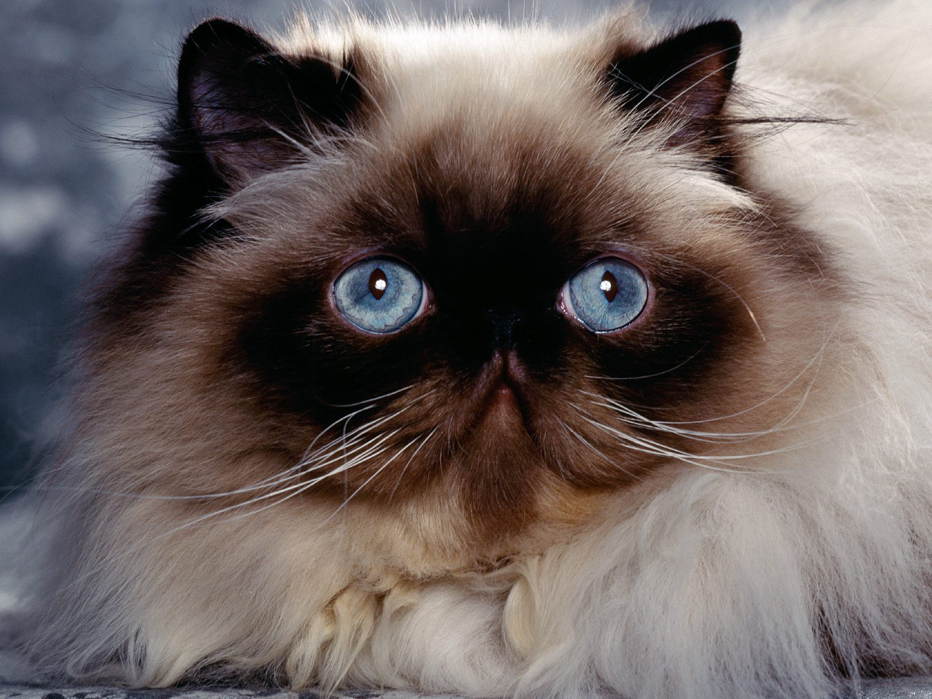
Extraction
10 000 pdfs
> 20 000 images
Comment construit-on des IA? – Guillaume Chervet

Slide 67
Extraction
10 000 pdfs
> 20 000 images
Comment construit-on des IA? – Guillaume Chervet

Slide 68
Dataset of 10 000 pdfs
20 000 images
Train a model
13 000
images train
4 000 images validation
3 000 images
test
1 000 PDFs integration
Comment construit-on des IA? – Guillaume Chervet

Slide 69
Data Distribution
Comment construit-on des IA? – Guillaume Chervet

Slide 70
Data Distribution
Un chat
Comment construit-on des IA? – Guillaume Chervet

Slide 71
Data Distribution
Un ornithorynque
Comment construit-on des IA? – Guillaume Chervet

Slide 72


Data Distribution
Comment construit-on des IA? – Guillaume Chervet

Slide 73
Data Distribution
Dataset of 10 000 pdfs
1% Cats
20% Dogs
79% Others
Comment construit-on des IA? – Guillaume Chervet
Notes:
Before starting the demo. Imagine that we have 20,000 files available. We will use 17,000 files for training the model. Then we will keep 3000 files aside for validation, to test our model on data it has never seen. This validation DATASET will also be used to test our production environments.

Slide 74

train | Cats: cat1.png, cat2.png, etc. Dogs: dog1.png, dog2.png, etc. Others: other1.png, other2.png, etc.
validation | Cats: cat3.png, cat4.png, etc. Dogs: dog3.png, dog4.png, etc. Others: other3.png, other4.png, etc.
test | Cats: cat5.png, cat6.png, etc. Dogs: dog5.png, dog6.png, etc. Others: other5.png, other6.png, etc.
integration | file1.pdf file2.pdf, etc. file1: image1.png, image2.png, images3.png file2: image1.png, image2.png
Comment construit-on des IA? – Guillaume Chervet

Slide 75
random.seed(11) pdfs = [ p for p in Path(input_pdfs_directory).iterdir() if p.is_file() and p.suffix == ".pdf" ]
random.shuffle(pdfs)
Comment construit-on des IA? – Guillaume Chervet

Slide 76
How many data do I need ?
Comment construit-on des IA? – Guillaume Chervet
Notes:
Before starting the demo. Imagine that we have 20,000 files available. We will use 17,000 files for training the model. Then we will keep 3000 files aside for validation, to test our model on data it has never seen. This validation DATASET will also be used to test our production environments.

Slide 77
Extraction
Dataset pdfs
DataSplit
Train
Dataset labels
Comment construit-on des IA? – Guillaume Chervet

Slide 78
Rank-1 tensors
x = np.array([18,3,6,14])
x.dim
>>> 1
Comment construit-on des IA? – Guillaume Chervet

Slide 79
Rank-2 tensors
x = np.array([[18,3,6,14],
[17,1,0,91],
[16,0,0,82]])
x.dim
>>> 2
Comment construit-on des IA? – Guillaume Chervet

Slide 80
Rank-3 tensors
x = np.array([[[18,3,6,14],
[17,1,0,91],
[16,0,0,82]],
[[18,3,6,14],
[17,1,0,91],
[16,0,0,82]],
[[18,3,6,14],
[17,1,0,91],
[16,0,0,82]]])
x.dim
>>> 3
Comment construit-on des IA? – Guillaume Chervet

Slide 81
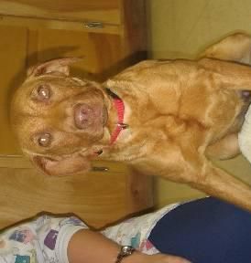
Layer 1
Layer 2
Layer …
Layer N-1
Layer N
Cat
Dog
Other
Comment construit-on des IA? – Guillaume Chervet

Slide 82
Layer 1
Layer 2
Layer …
Layer N-1
Layer N
Cat
Dog
Other
Comment construit-on des IA? – Guillaume Chervet

Slide 83

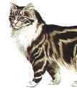
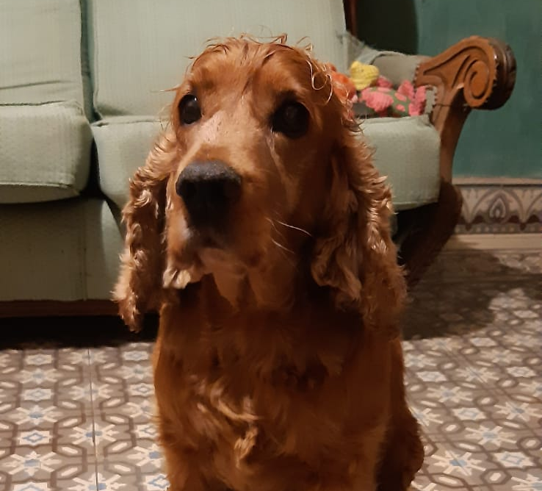
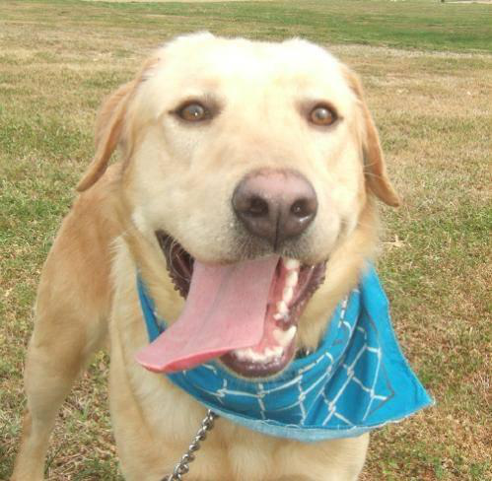
Predictions Groudtruth
Layer 1 Data transformation
Layer … Data transformation
Layer 2 Data transformation
Layer N-1
Data transformation
Layer N
Predictions
Loss Function
Loss Score
Optimizer
Update Weight
Comment construit-on des IA? – Guillaume Chervet

Slide 84
Loss value
Parameters value
Comment construit-on des IA? – Guillaume Chervet

Slide 85
Loss value
Derivative
Parameters value
Comment construit-on des IA? – Guillaume Chervet

Slide 86
Learning rate
Starting point
Loss value
t=0
t=1
t=2
t=3
Parameters value
Comment construit-on des IA? – Guillaume Chervet

Slide 87
Velocity
Local
minimum
Loss value
Local
minimum
Global
minimum
Parameters value
Comment construit-on des IA? – Guillaume Chervet

Slide 88
Extraction
Model registry
Dataset pdfs
DataSplit
Train
Test
Dataset Integration
Dataset labels
Comment construit-on des IA? – Guillaume Chervet

Slide 89
Confusion matrix
 |  | Classe estimée par l’IA
 |  | Chien | Chat | Autre
Vérité | Chien | 95 (vrais positifs) | 4 (faux négatifs) | 1 (faux négatifs)
 | Chat | 1 (faux positifs) | 97 (vrais négatifs) | 2 (faux positifs)
 | Autre | 2 (faux positifs) | 2 (faux positifs) | 96 (vrais négatifs)
Comment construit-on des IA? – Guillaume Chervet

Slide 90
Extraction
Model registry
Dataset pdfs
DataSplit
Train
Test
Dataset Integration
Dataset labels
Comment construit-on des IA? – Guillaume Chervet

Slide 91
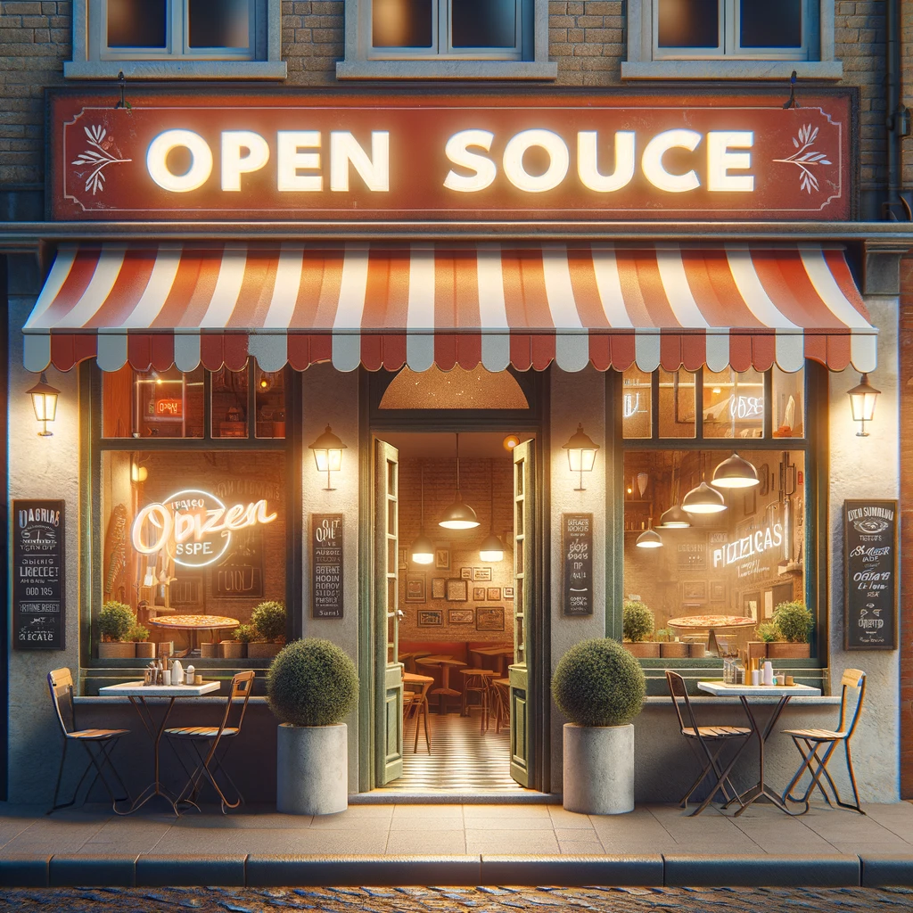
Recipes for success
Dailyclean
Ecotag
SlimFaaS
SlightCapture
Comment construit-on des IA? – Guillaume Chervet
Notes:
MLOPS is not centered on tools, however thanks to our projects, we have been able to set up tools and open source them. It is a pleasure to share them with you.
The daily clean allows us to automatically shut down Kubernetes environment.
Ecotag allows us to make labelling and comply with GDPR rules.
ml-cli is our integration test tool.

Slide 92

Conclusion
"three people hugging"
Comment construit-on des IA? – Guillaume Chervet
Notes:
To conclude, MLOPS is above all a culture of sharing.
Today we have projects that are at the top of the top of the complexity and if we do not put everything in place to help experts to work together.
To understand that the problem of one is the problem of the other.
It can't work.
A production ready project should also be a final focus.
The key to success comes in this sharing and working together.
Comprendre le droit à l’erreur.
Dur avec le code doux avec les gens

Slide 93


Slide 94
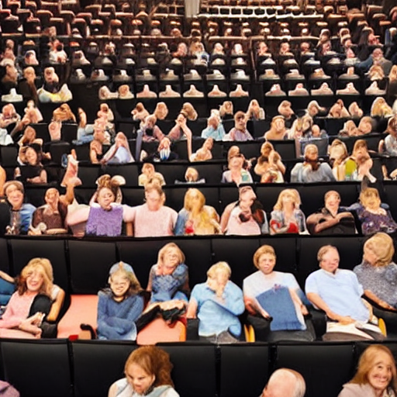
Thank you ☺
"thank and hug the public in a theater"
Le MLOps est une aventure Humaine– Guillaume Chervet
Notes:
To conclude, MLOPS is above all a culture of sharing.
Today we have projects that are at the top of the top of the complexity and if we do not put everything in place to help experts to work together.
To understand that the problem of one is the problem of the other.
It can't work.
A production ready project should also be a final focus.
The key to success comes in this sharing and working together.
Comprendre le droit à l’erreur.
Dur avec le code doux avec les gens

Slide 95
